Slide 1
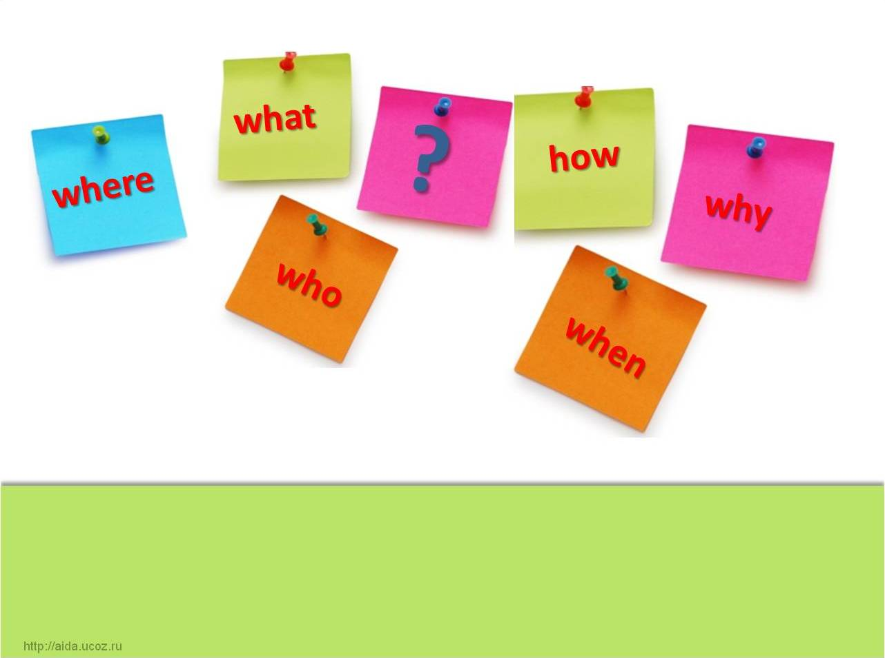


Let’s revise the tenses

Slide 2
Remember!
 | Simple | Continuous | Perfect
Present | V1 | Am Is Ving Are | Have Has V3
Past | V2
Future | Shall/ will V1

Slide 3
Remember the words that can help you
Present Simple
Sometimes, usually, always, often,
Every day( week, month, year)
Present Perfect
Ever, never, already, yet, just
Recently, lately
Past Simple
Future Simple
Present Continuous
Yesterday, two days ago, in 1959
Last week(month, year)
Tomorrow, in2037
Next day(week, month, year)
Now, at the moment

Slide 4

Simple tenses: help Jane tell her story
I often (go) to the park with my friends. We (like) running and playing there. The park (be) very beautiful. There (be) a lot of trees and flowers there.
Last Sunday we (see) a new film in the cinema. But we (not like) it because it (be) dull. And we (go) to our park. The weather (be) fine. We (swim) in the lake, (eat) ice-cream and (have) fun.
Next Sunday my parents and me (be) go for a walk in the forest. I hope it (be) warm and sunny. We (have) a picnic.

Slide 5
Simple tenses: correct the mistakes
I saw the film tomorrow.
He did dance at the party yesterday.
They usually will go to school at 7.
Did he got up early?
What you will do next Sunday?
They usually not talk at the lesson.

Slide 6
Present Simple or Present Continuous?
-Where is Mary?
She (have) dinner in the kitchen.
After school she (have) dinner and (do) her homework.
What … you (do) in the evening?
What… you (do) now?
I (not know) how to translate the text.
I usually (help) my mum in the evening but now I (play) my new computer game.

Slide 7
Past Simple or Present Perfect?
The room is clean now because my mum just (clean) it.
I (clean) my room two days ago.
Mike (get) a five last Maths lesson.
Mike is happy. He (get) a five!
5. He already (do) his home exercise.
6. She (do) her home exercise yesterday.
7. Jim (be) in Moscow last month.
8. Jane never (be) to Moscow.

Slide 8
Which tense should you use?
He (read) a book now.
He (be)to London twice
They (go) there last Sunday.
Look at him! He (ride) his bike.
I (do) my homework tomorrow.
She (see) her friends last week.
is reading
has been
went
is riding
will do
saw

Slide 9
Can you ask questions?
…he go to school last week?
What … she reading?
When …you usually get up?
What … they watching ?
What …you done?
When …she usually go to bed?
are
have
did
do
does
is
has

Slide 10
Correct the mistakes
She wash up yesterday.
They didn’t went to the park.
We is reading now.
Where does she saw it?
He not is listening to me
I has seen the film.
Did you were at school?
Does you swim well?
She washed up yesterday
They didn’t go to the park
We are reading now.
Where does she see it?
He is not listening to me.
I have seen the film.
Were you at school?
Do you swim well?

Slide 11
Which sentence best describes the picture?
*She played with her bear.
*She is playing with her bear.
*She will play with her bear
*She has done the shopping.
*She did the shopping.
* She is doing the shopping.
*It rains.
*It will rain.
*It’s raining.

Slide 12
Do you remember how to ask questions?
Why does Ann swim a lot?
Ann swims a lot.
Jack went there.
Liz has seen it.
The cat is playing.
When did Jack go there?
When?
Why?
Where?
What?
What has Liz seen?
Where is the cat playing?

Slide 13
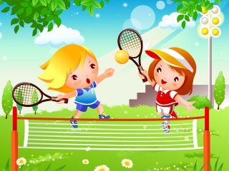
Look at the picture. You can see Jane and Liz. Answer the questions using the correct tense
What season is it now? What is the weather like?
Are the girls sisters or friends?
What are the girls doing?
Have they finished the game?
What does Jane usually do after classes?
Where did Liz go with her parents yesterday ?
What will Jane do after dinner?
Has Liz done her homework?
What did Jane’s parents buy her for birthday?

Slide 14

Thanks! Your work is good!

